Slide 1
Title:
AUTO-SPARE PART MANAGEMENT

Slide 2
TEAM MEMBERS
ANUJ - RA2011003010910
BASIM AHAMED - RA2011003010925
Rhythm Pahwa - RA2011003010936

Slide 3
ABSTRACT
The Auto-Spare Part Management is developed for sale/purchase organization. This system manages customer, product, sales order, and dealer and purchase order.
It provides a platform to the trader to automate their record keeping.
The purpose of this project is to develop an application program to reduce the manual work for managing inventory, product, customer, dealer and orders.

Slide 4
ABSTRACT
This project is built to help admin in managing his organization. Admin can store customer details in the database.
Next time when customer comes in then there is no need to enter his details again. It can selected from the list displaying all customer.
The traditional approach to be replaced by centralized monitoring database by maintaining records.

Slide 5
Problem statement
The main reason to build this project is to provide the seller a in-look of the shop.
This project wills the guide owner to the products available in the shop and which are required to order from the sellers.
By this, shopkeeper doesn’t have to keep track of the records manually.
The more comfortable users of computerized systems were mostly users with a fair accounting knowledge. In some cases business owners left the entire system to the accountant who was more familiar with the system, a situation some said possess a business risk.

Slide 6
Problem statement
Deductions from the requirements analysis show that ease of use and knowledge prerequisite are the main reasons why most SMEs are not able to adopt computerized systems fully for tracking and managing their sales processes.
This situation makes them stick to old and sometimes wasteful methods of tracking sales. The effect of this is loss of profits due to poor record keeping.
Project managers use feasibility studies to discern the pros and cons of undertaking a project before they invest a lot of time and money into it.

Slide 7
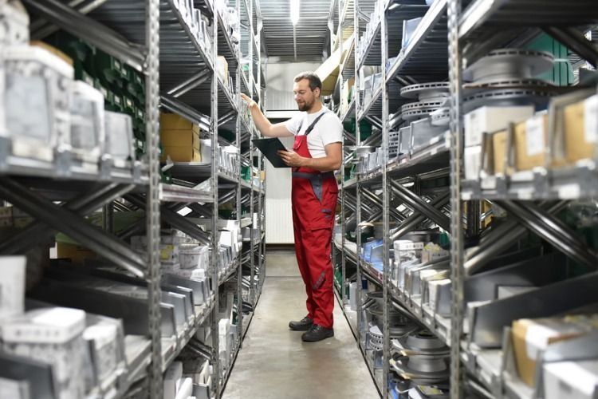

Slide 8
ObJective
Discuss the different classifications of service parts.
Analyse the importance of spare part management.
Explain how maintenance policies impact maintenance economics.
Analyse mathematical models for spare parts decision making.

Slide 9
ObJective
Analyse mathematical models for spare parts decision making.
Define classification and other models for spare part decision making.
Discuss the major issues in optimally managing spare parts.
Assess the success factors of spare parts management.

Slide 10
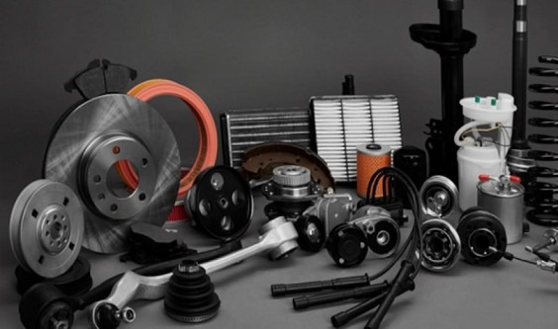

Slide 11
SCOPE
Scope of Auto-Spare Part Management:
•Admin can store all customer and dealer record.
•This application keeps tracks of all the products being sold in the organization.
•This system provides facility of making sales and purchase order.
•All products, customer and dealer record is maintained as master data. User can selected these from display list while making sales order and purchase order

Slide 12
limitation
The process of gathering information and the record is time consuming. Since the system, response time is high.
Only the person who manages it regularly can handle it in proper direction.
The system allows one participant to register for only one event.
A single user can’t get registered for more than one event

Slide 13
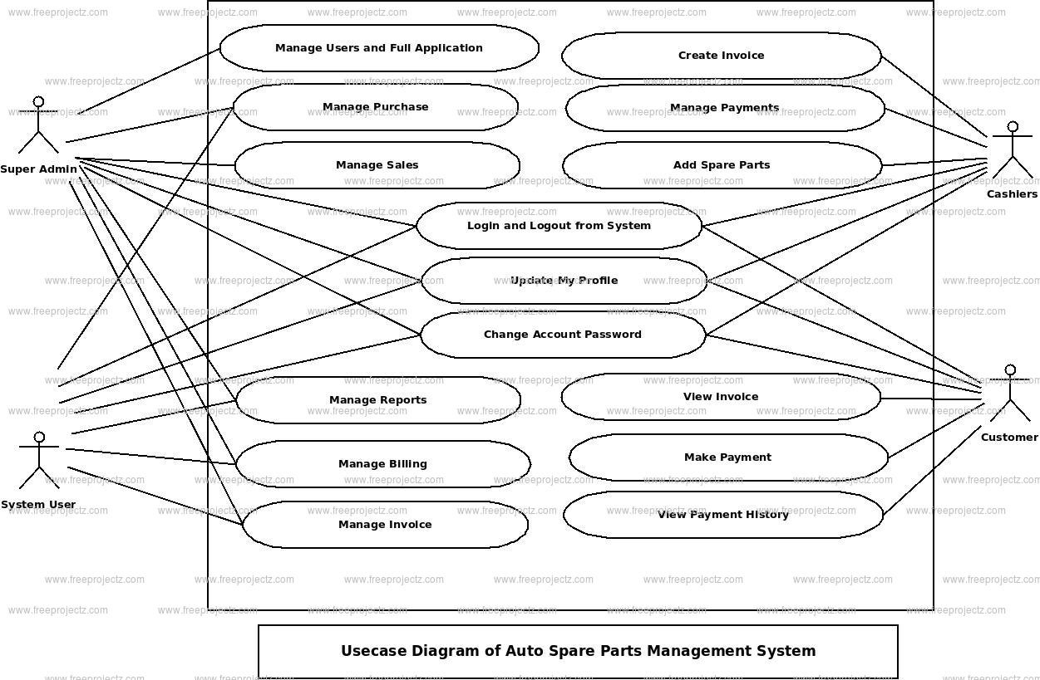
USEcase diagram

Slide 14
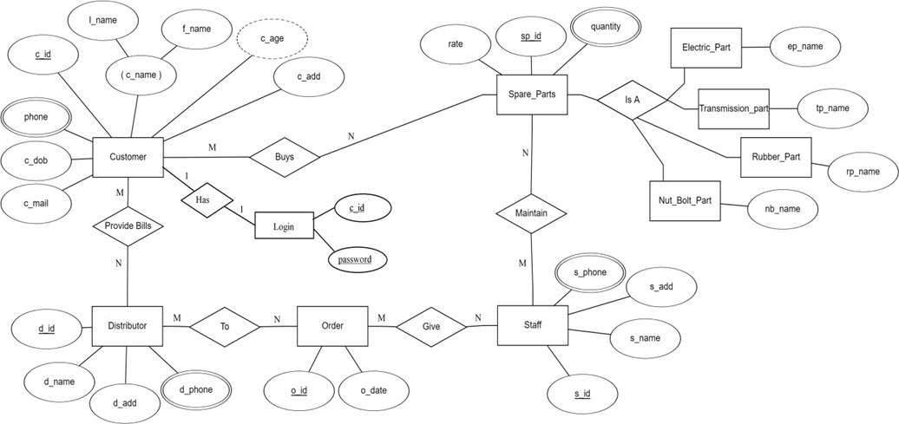
ER-diagram

Slide 15
References
http://docs.oracle.com/cd/B12037_01/server.101/b10739/create.htm2.
http://docs.oracle.com/javafx/index.html3.
http://stackoverflow.com/questions/15482623/javafx-1-3-listview4.
http://stackoverflow.com/questions/8392119/javafx-1-3-crud-using-listview5.
http://docs.oracle.com/cd/E17802_01/javafx/javafx/1.3/docs/api6.

Slide 16
References
http://docs.oracle.com/cd/E17802_01/javafx/javafx/1.3/docs/api6.
https://www.tutorialspoint.com/php/index.htm7.
https://www.w3schools.com/php/DEFAULT.asp8.
“Database System Concepts” by Henry Korth.9.
“Mysql” by Paul Dubois.

Slide 17
Thank you

